Slide 1
Knowledge and Reasoning

Slide 2
Objectives
Knowledge Representation
Propositional Logic
Rules of Inference
Wumpus World Example

Slide 3
Knowledge Representation
Knowledge is defined as "The act or state of knowing; clear perception of fact, truth or duty; certain apprehension." [Webster Dictionary]
Knowledge in AI is represented using a formal language
The formal language enables AI programs to perform reasoning and logical inferences
Knowledge-based Agents
  “agents that reason by operating on internal representations of knowledge”

Slide 4
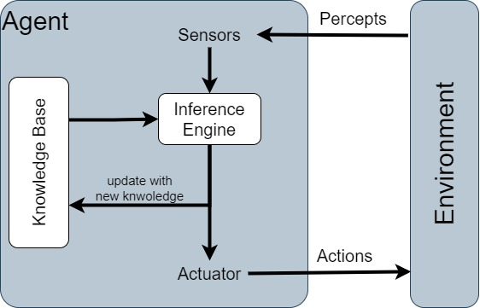
Knowledge-Based Agent
Knowledge-based agents are those agents who have the capability of
  Maintaining an internal state of knowledge
  Reason over that knowledge
  Update their knowledge after observations and take actions
These agents can represent the world with some formal representation and act intelligently
Notes:
Reference: https://www.javatpoint.com/knowledge-based-agent-in-ai

Slide 5
Knowledge-Based Agent
Agent that uses -prior or acquired- knowledge to achieve its goals
  Can make informed decisions
  Can make more efficient decisions
Knowledge Base (KB): contains a set of facts (called statements) about the Agent’s environment.
The agent should be able to:
  Update the knowledge base with new facts perceived from the environment (TELL)
  ASK the KB about known facts and what to do
  Derive new facts from already known facts (inference)

Slide 6
Knowledge-Based Agents
Every time the agent program is called, it does three things.
  First, it TELLs the knowledge base what it perceives.
  Second, it ASKs the knowledge base what action it should perform.
  Third, the agent program TELLs the knowledge base which action was chosen, and the agent executes the action.
  Example:
  Agent to KB (TELL): detecting (perceiving) car brakes failure.
  Agent to KB (ASK): What to do.
  KB to Agent: downshift, pump brakes, slowly apply emergency brake.
  Agent to KB (TELL): Will pump the brakes.
  Agent: pumping the brakes
Notes:
Reference: Russlle Book section 7.1 (pg. 236)

Slide 7
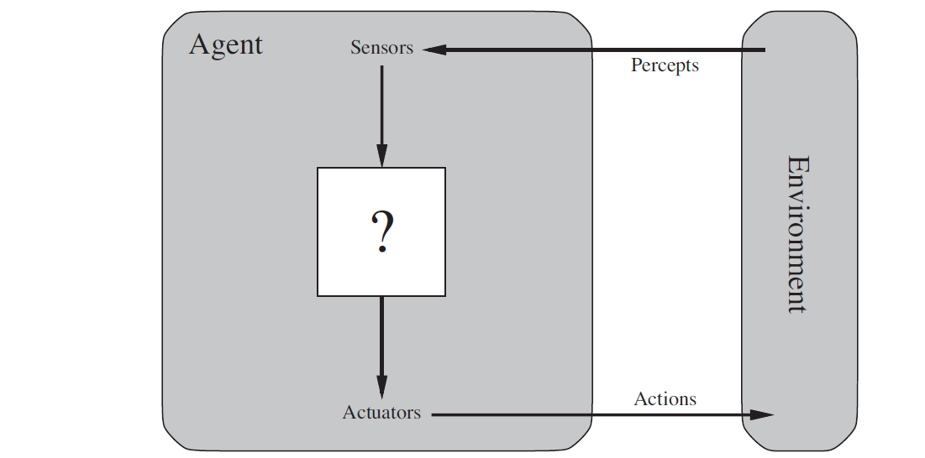
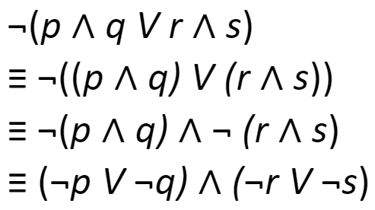
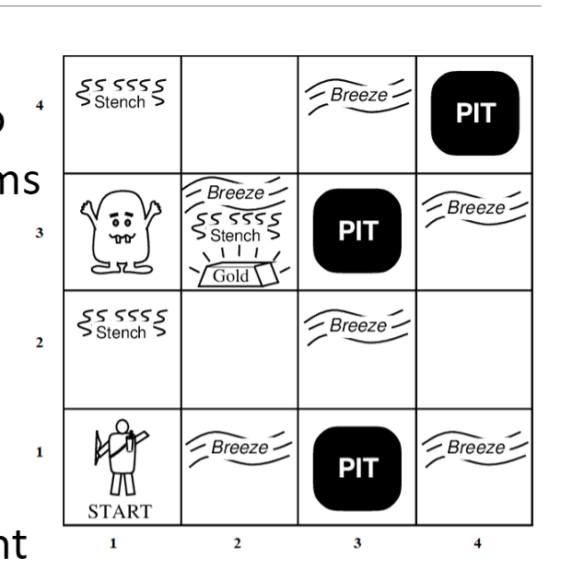
Logic-Based Agent
  A knowledge-based agent
  It uses Logic to represent the knowledge about the environment (world).
Propositional
Logic
Wumpus World Example

Slide 8
Propositional Logic
Propositional Logic is the logic of compound statements built from simpler statements using so-called Boolean connectives.
Some applications:
  Design of digital logic circuits (Computer Engineering)
  Expressing conditions in programs
  Queries to databases & search engines
  Inference and Decision Making
    Example: “If today is Tuesday, I have a test in English or Science.
    If my English Professor is absent, then I will not have a test in English.
    Today is Tuesday and my English Professor is absent.
    Therefore, I have a test in Science.“

Slide 9
Propositional Logic Definition
A proposition (denoted P, Q, R, p, q, r, …)
  is a statement (i.e., a declarative sentence)
  with some definite meaning, (not vague or ambiguous)
  having a truth value that is either TRUE (T) or FALSE (F)
    it is never both, neither, or somewhere “in between!”
    however, the actual truth value might not be known and might depend on the situation or context

Slide 10
Propositions vs. Non-Propositions
Examples of Propositions:
  “It is raining.” (In a given situation.)
  “Riyadh is the capital of Saudi Arabia.”
  “1 + 2 equals 3”
Examples of Non-Propositions:
  “Who is there?” (interrogative, question)
  “Concentrate, please!” (imperative, command)
  “No, no, no, no, no,...” (meaningless interjection)
  “Just do it!” (imperative, command)
  “Yeah, I have no idea, whatever...” (vague)
  “1 + 2” (expression with a non-true/false value)

Slide 11
Operators/Connectives
An operator, or connective, combines one or more operands to form a larger expression.
    Example:
      “+” in numeric expressions
      “and” in logic expressions
There exist two types of operators:
  Unary operators: take 1 operand (e.g., −3, not(P), ¬P)
  Binary operators: take 2 operands (e.g., 3 × 4, p and q).
Propositional, or Boolean operators, operate on propositions (or their truth values) instead of on numbers.

Slide 12
Boolean Operators
Formal Name | Nickname | Arity | Symbol
Negation | NOT | Unary | ¬
Conjunction | AND | Binary | ∧
Disjunction | OR | Binary | ∨
Exclusive-OR | XOR | Binary | ⊕
Implication | IMPLIES | Binary | →
Biconditional | IFF | Binary | ↔

Slide 13
The Negation Operator (Not) “¬”
The unary negation operator “¬” (NOT) transforms a proposition into its logical negation.
Examples:
  if p = “it is raining today.”, then ¬p = “it is not raining today.”

Slide 14
The Negation Operator (Not) “¬” – Truth Table
A truth table displays the relationships between truth values (T or F) of different propositions.
The truth table of the negation operator
Operand: P | Result: ¬ P
T | F
F | T
T = True; F = False

Slide 15
The Conjunction Operator (AND) “∧”
The binary conjunction operator “∧” (AND) combines two propositions to form their logical conjunction.
Example:
  If p = “I will have salad for lunch.” and
  q = “I will have steak for dinner.”, then
  p ∧ q = “I will have salad for lunch, and I will have steak for dinner.”

Slide 16
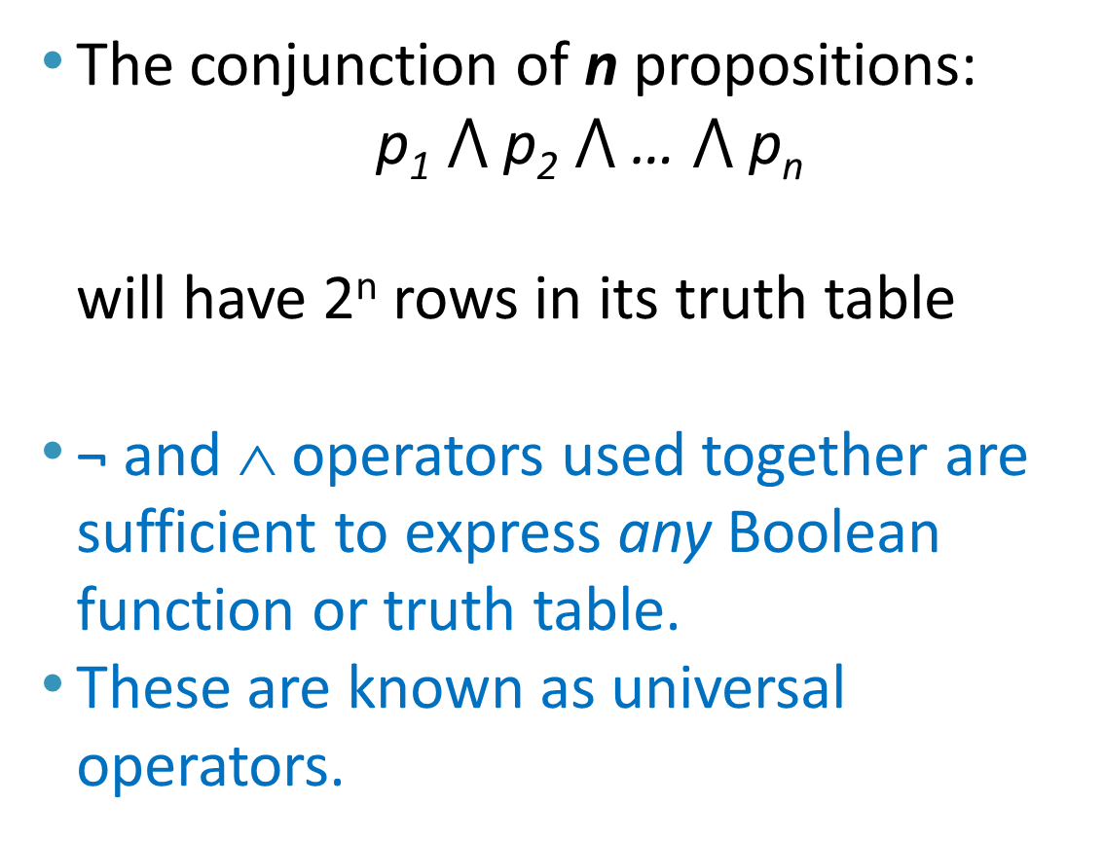
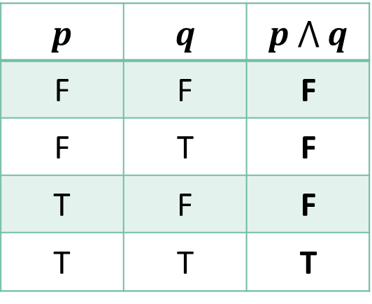
The Conjunction Operator (AND) “∧” – Truth Table
The conjunction of n propositions:
  p₁ $⋀$ p₂ $⋀$ … $⋀$ p_{n}
  will have 2^{n} rows in its truth table
¬ and ∧ operators used together are sufficient to express any Boolean function or truth table.
These are known as universal operators.
p | q | p $⋀$ q
F | F | F
F | T | F
T | F | F
T | T | T

Slide 17
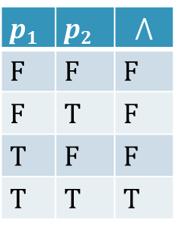
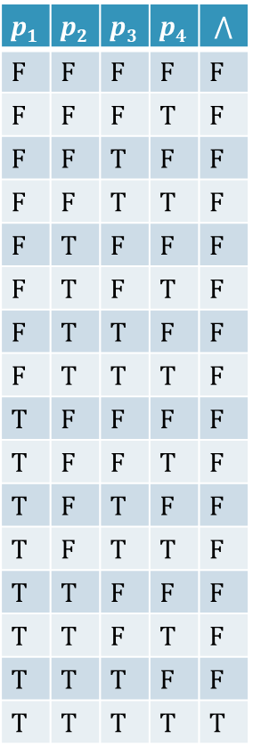
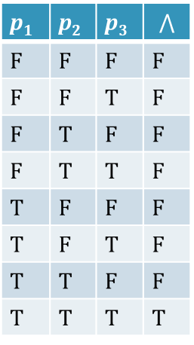
Conjunction Truth Table Examples
p₁ | p₂ | p₃ | p₄ | $$⋀$$
F | F | F | F | F
F | F | F | T | F
F | F | T | F | F
F | F | T | T | F
F | T | F | F | F
F | T | F | T | F
F | T | T | F | F
F | T | T | T | F
T | F | F | F | F
T | F | F | T | F
T | F | T | F | F
T | F | T | T | F
T | T | F | F | F
T | T | F | T | F
T | T | T | F | F
T | T | T | T | T
p₁ | p₂ | p₃ | $$⋀$$
F | F | F | F
F | F | T | F
F | T | F | F
F | T | T | F
T | F | F | F
T | F | T | F
T | T | F | F
T | T | T | T
p₁ | p₂ | $$⋀$$
F | F | F
F | T | F
T | F | F
T | T | T
# rows = 2⁴ = 16
# rows = 2² = 4
# rows = 2³ = 8
Generally, # rows = 2^{n}, where n is the number of propositions

Slide 18
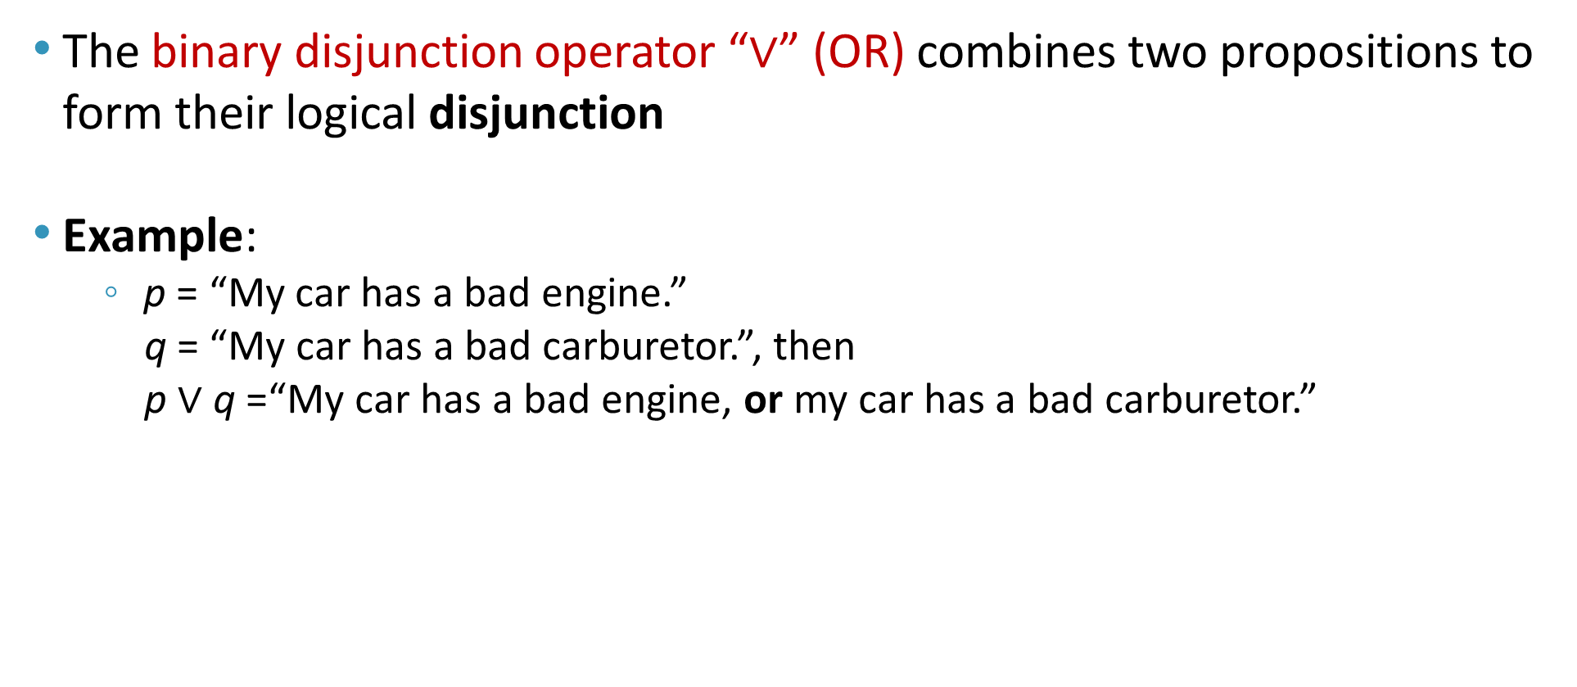
The Disjunction Operator (OR) “∨”
The binary disjunction operator “∨” (OR) combines two propositions to form their logical disjunction
Example:
    p = “My car has a bad engine.”
    q = “My car has a bad carburetor.”, then
    p $∨$ q =“My car has a bad engine, or my car has a bad carburetor.”

Slide 19
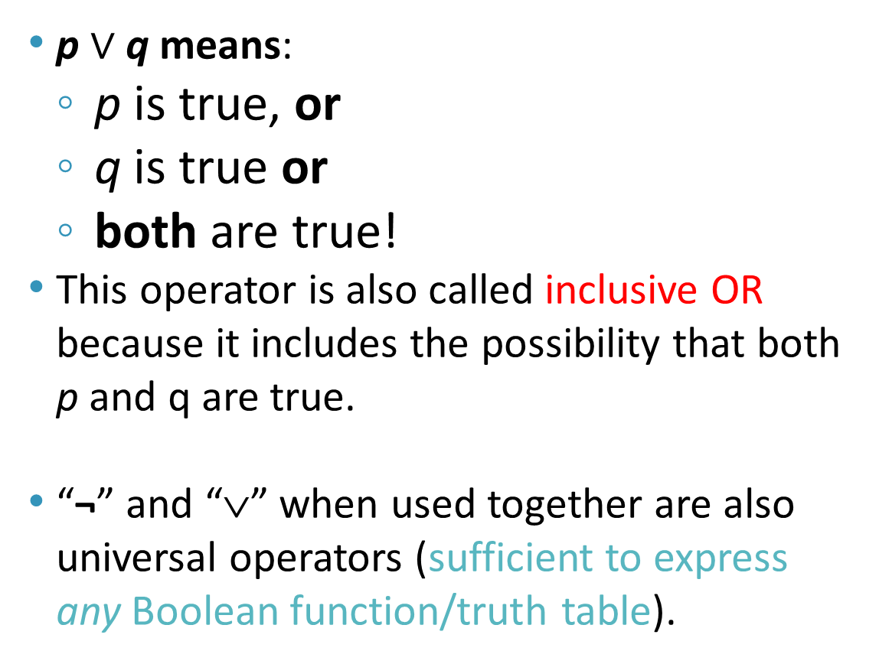
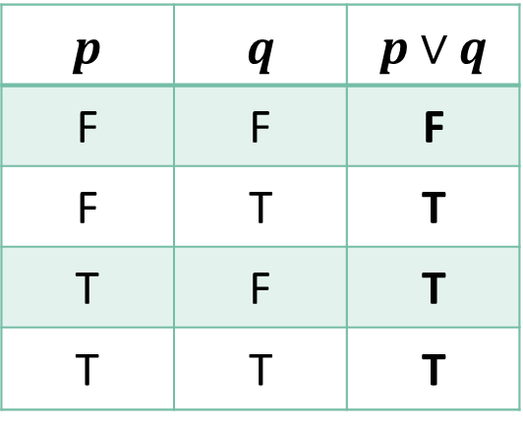
The Disjunction Operator (OR) “∨” – Truth Table
p $∨$ q means:
  p is true, or
  q is true or
  both are true!
This operator is also called inclusive OR because it includes the possibility that both p and q are true.
“¬” and “∨” when used together are also universal operators (sufficient to express any Boolean function/truth table).
p | q | p$∨$ q
F | F | F
F | T | T
T | F | T
T | T | T

Slide 20

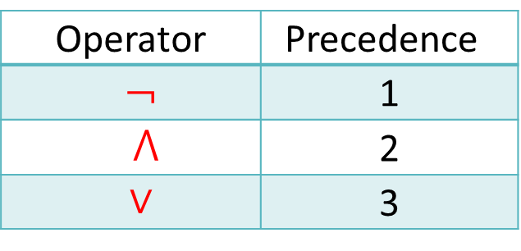
Nested Propositional Expressions
A nested propositional expression is constructed using several propositions connected with the operators: AND, OR, NOT
where parentheses are used to group sub-expressions
  Example:
    f $V$ (g $⋀$ s) is a proposition that would mean something different than (f $V$ g) $⋀$ s
    f ∨ g $⋀$ s would be ambiguous (if operator precedence rules are not used)
By convention, the “¬” operator has precedence over both “∧” and “∨” operators:
    ¬s ∧ f means (¬s) ∧ f but not ¬ (s ∧ f)
Operator | Precedence
¬ | 1
$⋀$ | 2
∨ | 3

Slide 21
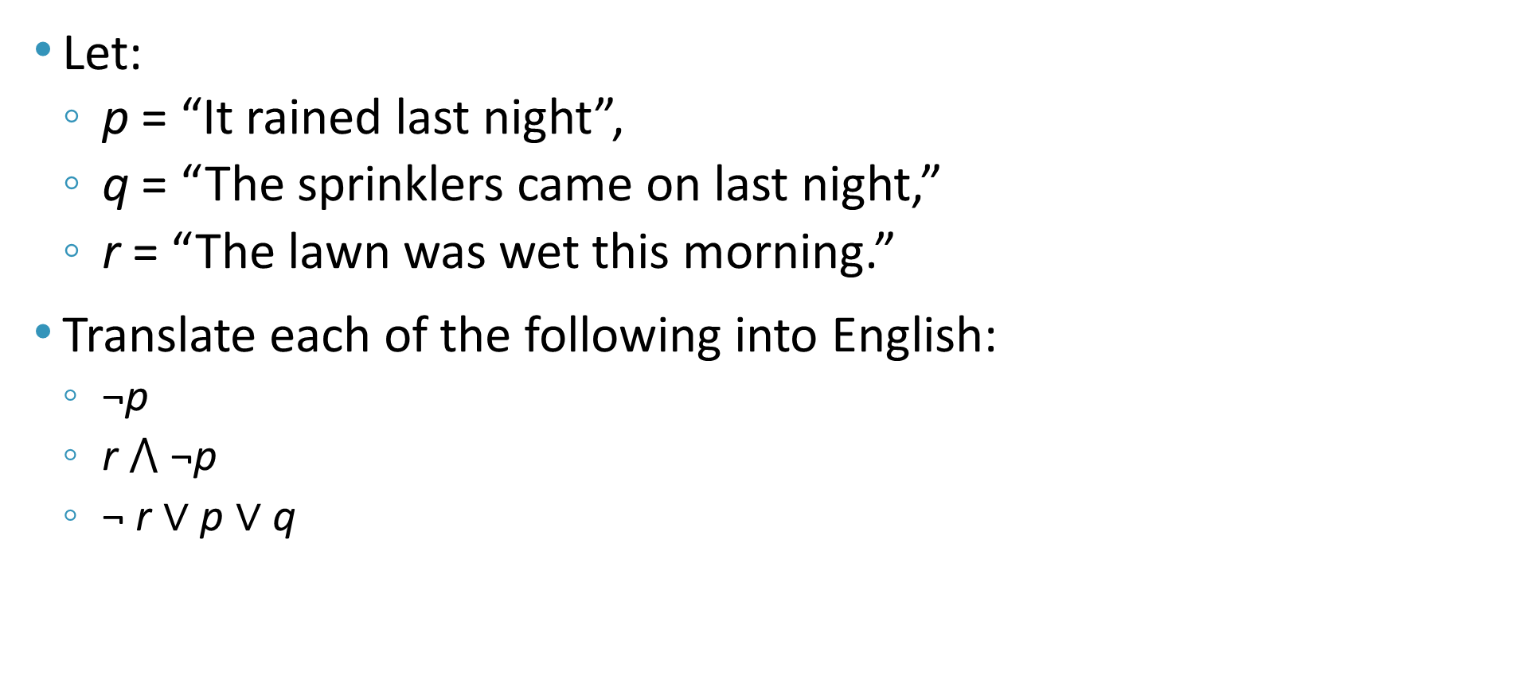
Propositional Expressions - Examples
Let:
  p = “It rained last night”,
  q = “The sprinklers came on last night,”
  r = “The lawn was wet this morning.”
Translate each of the following into English:
  ¬p
  r $⋀$ ¬p
  ¬ r ∨ p ∨ q
= “It did not rain last night.”
= “The lawn was wet this morning, and it did not rain last night.”
= “The lawn was not wet this morning, or it rained last night, or the sprinklers came on last night.”

Slide 22
The Exclusive Disjunction Operator (XOR) “⊕”
The binary exclusive-or operator “⊕” (XOR) combines two propositions to form their logical “exclusive or”
  p = “I will earn an A+ in this course,”
  q = “I will drop this course,” then
  p ⊕ q =
  “I will either earn an A+ in this course,
  or I will drop it
  (but not both!)”

Slide 23
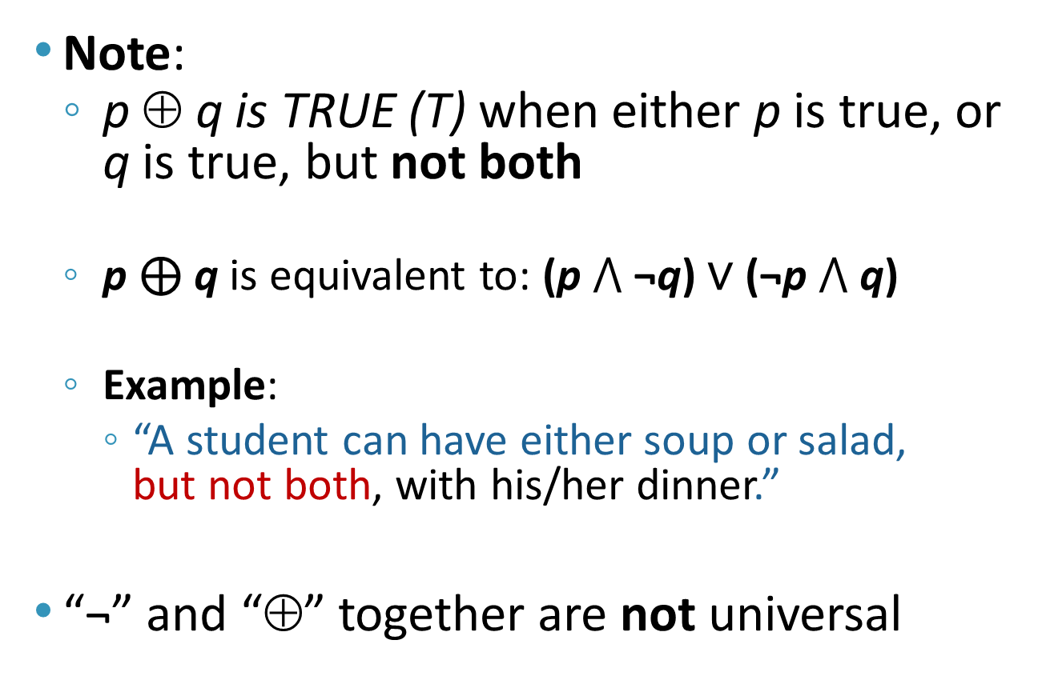
The Exclusive Disjunction Operator (XOR) “⊕” - Truth Table
Note:
  p ⊕ q is TRUE (T) when either p is true, or q is true, but not both
  p ⊕ q is equivalent to: (p $⋀$ ¬q) ∨ (¬p $⋀$ q)
  Example:
    “A student can have either soup or salad,
    but not both, with his/her dinner.”
“¬” and “⊕” together are not universal
p | q | p ⊕ q
F | F | F
F | T | T
T | F | T
T | T | F

Slide 24
Inclusive OR “∨” vs. Exclusive OR “⊕”
Note that the English “OR” can be ambiguous regarding the “both” case!
“Noor is a teacher or Noor is a writer.” ∨
“Noor is a man or Noor is a woman.” ⊕
Need context to disambiguate the meaning!
For this course, assume “or” means inclusive. i.e. either one, or both propositions can be true
p | q | p "OR" q
F | F | F
F | T | T
T | F | T
T | T | ?

Slide 25
The Implication Operator (implies) “→”
The implication p → q states that p implies q, i.e.,
  if p is true, then q is true;
  but, if p is not true, then q could be either true or false
Example
  Let p = “You study hard.”,
  q = “You will get a good grade.”
    p → q = “If you study hard, then you will get a good grade.” (else, it could go either way: if you don’t study hard, you may or may not get good grade)
antecedent
consequent

Slide 26
The Implication Operator (implies) “→”
The truth table of the implication operator is shown below
  p → q is false only when
  p is true but q is not true.
  p → q does not say
  that p causes q
  p → q does not require
  that p or q are ever true!
  p → q is equivalent to p ⊆ q
p | q | p → q
F | F | T
F | T | T
T | F | F
T | T | T
The only
False case!

Slide 27
The Implication Operator (implies) “→”
Examples of Implications
  If this lecture ever ends, then the sun will rise tomorrow.” [True]
  “If Tuesday is a day of the week, then I am a penguin.” [False]
  “If the moon is made of green cheese, then I am richer than Bill Gates.” [True]
p | q | p → q
F | F | T
F | T | T
T | F | F
T | T | T

Slide 28
English Phrases for p → q
“p implies q”
“if p, then q”
“if p, q”
“when p, q”
“whenever p, q”
“p only if q”
“p is sufficient for q”
“q is implied by p”
“q if p”
“q when p”
“q whenever p”
“q is necessary for p”
“q follows from p”
p | q | p → q
F | F | T
F | T | T
T | F | F
T | T | T
“p only if q” and “q is necessary for p” mean that p cannot be true when q is not true. That is, the statement is false if p is true, but q is false.

Slide 29
Examples of English uses of Implications
p
q
If you get 100% in the final, you will get an A+
  You get 100% in the final is sufficient to get an A+
  A sufficient condition to get an A+ is to get 100% in the final
  You get an A+ is necessary for you to get 100% in the final (but not sufficient)
  A necessary condition for you to get 100% is you get an A+
  Imagine that you know your letter grade and you are trying to guess your grade in the final:
    If you did not get A+ then for sure you didn't get 100%
    If you get A+ then you may or may not get 100%

Slide 30
Examples of English uses of Implications
If you show up on Monday, you will get the job
  You show up on Monday is sufficient for you to get the job
  A sufficient condition for you to get the job is to show up on Monday
  You get the job is necessary for you to show up on Monday
  A necessary condition for you to show up on Monday is you get the job

Slide 31
Examples of English uses of Implications
You walk 8 miles is necessary to get to the top
  Which of the following statements is equivalent?
    If you walk 8 miles, then you get to the top
    If you got to the top, then you have walked 8 miles
  The first statement is not equivalent, WHY?
    Suppose you walked 8 miles in the wrong direction!
    But if you got to the top then you are sure that you must have walked 8 miles.

Slide 32
Converse, Inverse, Contrapositive
The inverse of p → q is ¬p → ¬q
The converse of p → q is q → p
The contrapositive of p → q is ¬q → ¬p (if not q then not p)
One of these three has the same meaning (same truth table) as p → q. Can you figure out which?
  The contrapositive: ¬q → ¬p
    the contrapositive is false only when ¬p is false and ¬q is true, that is, only when p is true and q is false

Slide 33
Proving Equivalence between p → q and ¬q → ¬p
p | q
F | F
F | T
T | F
T | T
p → q
T
T
F
T
¬p
T
T
F
F
¬q
T
F
T
F
¬q → ¬p
T
T
F
T
p | q | p → q
F | F | T
F | T | T
T | F | F
T | T | T
A conditional statement is logically equivalent to its contrapositive

Slide 34
Converse, Inverse, Contrapositive - Example
Find the contrapositive, the converse, and the inverse of the conditional statement “The home team wins whenever it is raining.”
  Rewrite the statement as “If it is raining, then the home team wins.”
  The inverse (¬p → ¬q):
    “If it is not raining, then the home team does not win.”
  The converse (q → p):
    “If the home team wins, then it is raining.”
  The contrapositive (¬q → ¬p) :
    “If the home team does not win, then it is not raining.”

Slide 35
The Biconditional Operator “↔”
The biconditional p ↔ q states that p is true if and only if (IFF) q is true
Example:
  p = “Ali wins the club election.”
  q = “Ali will be the president of the club for this year.”
  p ↔ q = “If, and only if, Ali wins the club election, Ali will be the president of the club for this year.”

Slide 36
The Biconditional Operator “↔” - Truth Table
p ↔ q means that p and q have the same truth value
  p → q is equivalent to p ⊆ q
  q → p is equivalent to q ⊆ p
  Thus, q ≡ p
Note this truth table is the exact opposite of ⊕’s!
  Thus, p ↔ q means ¬(p ⊕ q)
p ↔ q does not imply that p and q are true, or that either of them causes the other, or that they have a common cause.
p | q | p ↔ q
F | F | T
F | T | F
T | F | F
T | T | T

Slide 37
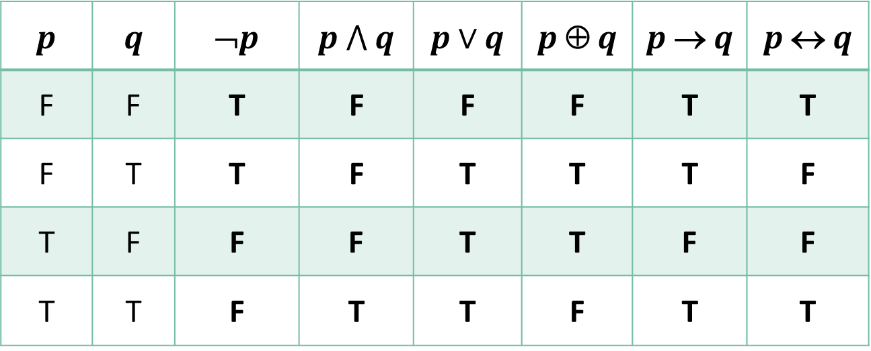
Boolean Operations Summary
p | q | ¬p | p $⋀$ q | p$∨$ q | p ⊕ q | p → q | p ↔ q
F | F | T | F | F | F | T | T
F | T | T | F | T | T | T | F
T | F | F | F | T | T | F | F
T | T | F | T | T | F | T | T

Slide 38
Boolean Operations Alternative Notations
Name | not | and | or | xor | implies | iff
Propositional logic | ¬ | ∧ | ∨ | ⊕ | → | ↔
Boolean algebra | ¯ | p.q (pq) | + | ⊕
C/C++/Java (wordwise) | ! | && | || | != |  | ==
C/C++/Java (bitwise) | ~ | & | | | ^
Logic gates
Python (logical operator) | not | and | or | != |  | ==

Slide 39
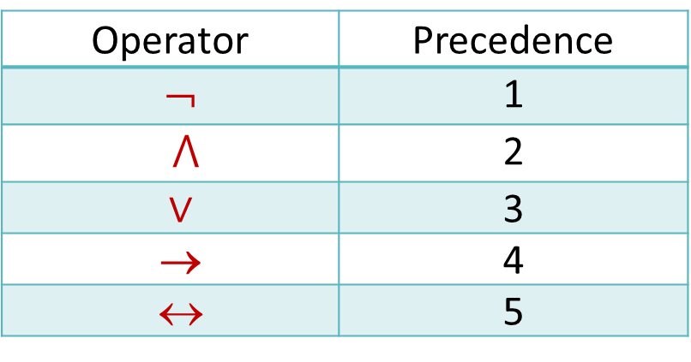
Precedence of Logical Operators
p ∨ q → ¬r is equivalent to (p ∨ q) → ¬r
If the intended meaning is p ∨ (q → ¬r ) then parentheses must be used.
Operator | Precedence
¬ | 1
$⋀$ | 2
∨ | 3
→ | 4
↔ | 5

Slide 40
Tautologies, Contradictions and Contingencies
A tautology is a proposition which is always True
  Example: p ∨ ¬p
A contradiction is a proposition which is always False
  Example: p ∧ ¬p
A contingency is a proposition which is neither a tautology nor a contradiction

Slide 41
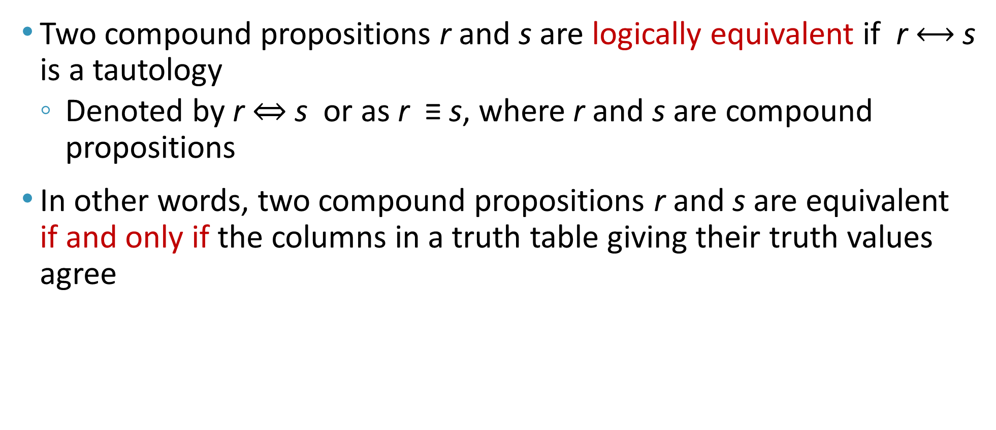
Logically Equivalent
Two compound propositions r and s are logically equivalent if r $⟷$s is a tautology
  Denoted by r ⇔ s or as r ≡ s, where r and s are compound propositions
In other words, two compound propositions r and s are equivalent if and only if the columns in a truth table giving their truth values agree

Slide 42
Logical Equivalence
The following truth table shows r : ¬p ∨ q is equivalent to s: p → q (and s is Equivalent to r)
p | q
F | F
F | T
T | F
T | T
¬p
T
T
F
F
¬p ∨ q
T
T
F
T
p → q
T
T
F
T

Slide 43
De Morgan’s Laws
¬(p ∧ q) ≡ ¬p ∨ ¬q, [first law]
¬(p ∨ q) ≡ ¬p ∧ ¬q, [second law]
¬p ∨ ¬q ≡ ¬(p ∧ q)
¬p ∧ ¬q ≡ ¬(p ∨ q)
p | q | ¬p | ¬q | (p ∨q)
F | F | T | T | F
F | T | T | F | T
T | F | F | T | T
T | T | F | F | T
¬(p ∨q)
T
F
F
F
¬p ∧¬q
T
F
F
F

Slide 44
De Morgan’s Laws
When applying De Morgan’s laws on compound propositional expressions, make sure to put brackets first around conjunctive operators
Example:
  ¬(p ∧ q V r ∧ s)
  ≡ ¬((p ∧ q) V (r ∧ s))
  ≡ ¬(p ∧ q) ∧ ¬ (r ∧ s)
  ≡ (¬p V ¬q) ∧ (¬r V ¬s)

Slide 45
Argument and Inference
Argument: a sequence of statements that end with a conclusion
Valid Argument: the conclusion or final statement of the argument must follow the truth of preceding statements or premises of the argument
  An argument is valid if and only if it is impossible for all the premises to be true and the conclusion to be false
Inference is the operation of deriving new facts from old ones.
Rules of inference: used to deduce (construct) new statements from statements that we already have
  Basic tools for establishing the truth of statements

Slide 46
Valid Arguments in Propositional Logic
Consider the following arguments involving propositions
“If you have a current password,
then you can login to the network”
“You have a current password”
therefore,
“You can login to the network”
p
p → q
q
p
premises
∴
conclusion
q
p → q
p
______
∴ q
p
p → q
______
∴ q

Slide 47
Valid Arguments
p
p → q
______
∴ q
(p ∧ (p → q)) → q is a tautology (always true)
p | q
F | F
F | T
T | F
T | T
p → q
T
T
F
T
p ∧ (p → q)
F
F
F
T
(p ∧ (p → q)) → q
T
T
T
T
∴ therefore
This is another way of saying that

Slide 48
Rules of Inference for Propositional Logic
Can always use truth table to show an argument form is valid
For an argument form with 10 propositional variables, the truth table requires 2¹⁰ rows (1024)
The tautology (p ∧ (p → q)) → q is the rule of inference called modus ponens (mode that affirms), or the law of detachment
Argument form: a sequence of compound propositions involving propositional variables
p
p → q
______
∴ q

Slide 49
Example
If both statements
  “If it snows today, then we will go skiing”
  “It is snowing today”
are true
By modus ponens,
  it follows the conclusion
    “We will go skiing”
    is true
p → q
p
p
p → q
______
∴ q
q

Slide 50
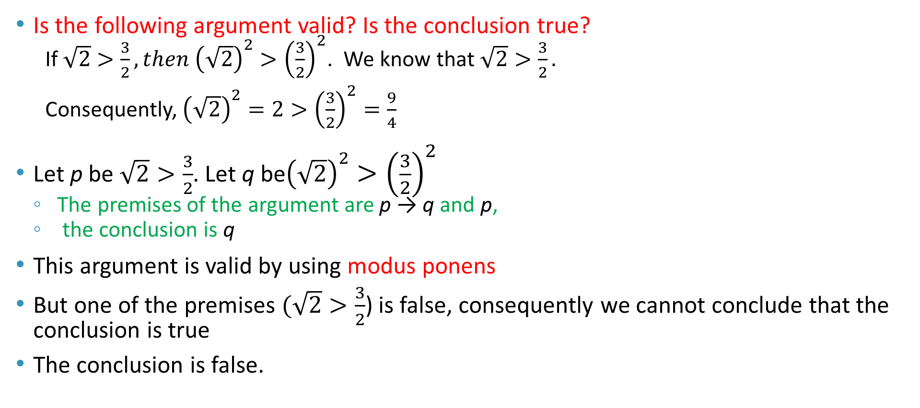
Example
Is the following argument valid? Is the conclusion true?
  If $\sqrt{2}>\frac{3}{2}, then {\left(\sqrt{2}\right)}^{2}>{\left(\frac{3}{2}\right)}^{2}$. We know that $\sqrt{2}>\frac{3}{2}.$
  Consequently, ${\left(\sqrt{2}\right)}^{2}=2>{\left(\frac{3}{2}\right)}^{2}=\frac{9}{4}$
Let p be $\sqrt{2}>\frac{3}{2}$. Let q be${\left(\sqrt{2}\right)}^{2}>{\left(\frac{3}{2}\right)}^{2}$
  The premises of the argument are p → q and p,
  the conclusion is q
This argument is valid by using modus ponens
But one of the premises $(\sqrt{2}>\frac{3}{2}$) is false, consequently we cannot conclude that the conclusion is true
The conclusion is false.
p → q
p
______
∴ q

Slide 51
Rules of Inference
Means to draw conclusions from other assertions
Rules of inference provide justification of steps used to show that a conclusion follows from a set of hypotheses (premises)
The next several slides illustrate specific rules of inference

Slide 52
Addition
A true hypothesis implies that the disjunction
of that hypothesis and another are true
p
_______
∴ p ∨ q
or p → (p ∨ q)

Slide 53
Simplification
If the conjunction of 2 propositions is true,
then each proposition is true
p ∧ q
_______
∴ p
or (p ∧ q) → p
p ∧ q
_______
∴ q
Also (p ∧ q) → q

Slide 54
Conjunction
If p is true and q is true, then p ∧ q is true
p
q
_______
∴ p ∧ q
or ((p) ∧ (q)) → p ∧ q

Slide 55
Modus Ponens
If a hypothesis and implication are both true,
then the conclusion is true
p
p → q
_______
∴ q
or (p ∧ (p → q)) → q

Slide 56
Modus Tollens
If a conclusion is false and its implication
is true, then the hypothesis must be false
¬q
p → q
_______
∴¬p
or (¬q ∧ (p → q)) → ¬p

Slide 57
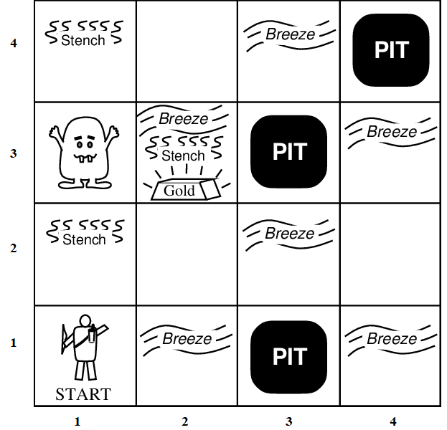
The Wumpus World Example
  The Wumpus world is a cave with 16 rooms (4×4). Each room is connected to other rooms through walkways. No rooms are connected diagonally.
  The knowledge-based agent starts from room [1, 1]. The cave has some pits, a treasure, and a beast named Wumpus.
  The Wumpus cannot move but eats the one who enters its room, and if the agent enters the pit, it gets stuck there.

Slide 58
The Wumpus World Example
  The goal of the agent is to take the treasure and come out of the cave.
    The agent is rewarded, when the goal conditions are met.
    The agent is penalized, when it falls into a pit or being eaten by the Wumpus.

Slide 59
The Wumpus World Example
Some elements support the agent to explore the cave:
  The Wumpus's adjacent rooms are stenchy (i.e., have bad smell).
  The adjacent rooms of the room with pits are filled with breeze.
  The agent is given one arrow which it can use to kill the Wumpus when facing it (Wumpus screams when it is killed).
  The treasure room is always glittery.
The agent starts with no information of where the pits, Wumpus and the gold are.

Slide 60
Wumpus World Characterization
Acronyms
  B = Breeze
  A = Agent
  G = Glitter
  OK = Safe room
  P = Pit
  S = Stench
  V = visited the room
  W = Wumpus
Is the Wumpus World | Answer | Why?
Deterministic? | Yes | outcome exactly specified
Observable? | No | only local perception
Static? | Yes | Wumpus and pits do not move
Discrete? | Yes | Wumpus can be in a certain room at a time
Episodic? | No | sequential at the level of actions.

Slide 61
The Wumpus World Example
Percepts: Breeze, Glitter, Smell
Actions: Left turn, Right turn, Froward, Backward, Grab, Release, Shoot
Goal: Get the gold and back to the starting point (square [1,1]) without falling into a pit or being eaten by the wumpus.
Environment:
  Squares adjacent to the Wumpus are smelly
    S_{x,y} → W_{x+1,y} V W_{x-1,y} V W_{x,y+1} V W_{x,y-1}
  Squares adjacent to pit are breezy
    B_{x,y} → P_{x+1,y} V P_{x-1,y} V P_{x,y+1} V P_{x,y-1}
  Glitter if and only if gold is in the same square.
  Shooting kills the Wumpus if you are facing it.
  Grabbing picks up the gold if in the same square.
  Releasing drops the gold in the same square.

Slide 62
The Wumpus World Example
Let’s assign a Utility measure as shown below:
  +1000 for climbing out of the cave with the gold (End),
  -1000 for falling into a pit or being eaten by the Wumpus (End),
  –1 for each action taken, and
  –10 for using up the arrow.
The Environment description:
  In a 4×4 grid of rooms, the agent starts in square [1,1], facing right.
  The gold and the Wumpus locations are randomly chosen uniformly, in any room other than room [1,1].
  Each room other than the start can be a pit, with a probability of 0.2.

Slide 63
The Wumpus World Example
Sensors:
  Perceive a Stench in the squares adjacent to the Wumpus
  Perceive a Breeze in the squares adjacent to a pit
  Perceive a Glitter in the square where the gold is
  Perceive a Bump when the agent walks into a wall
  Perceive a woeful (i.e. unhappy) Scream anywhere in the caves when the Wumpus is killed
  Perceive “None” if all the adjacent rooms neither have a pit nor a Wumpus
Actuators:
  Left turn
  Right turn
  Move forward
  Move backward
  Grab gold
  Release gold
  Shoot arrow

Slide 64
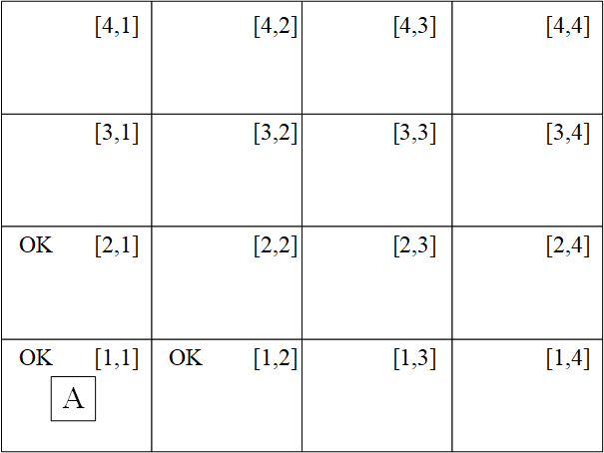
Wumpus World Solution
Step 1:
  Since A does not perceive anything → room [1,1] is OK.
  Since A does not perceive anything in [1,1] → room [1,2] and room [2,1] are OK.
  The agent must choose between room [1,2] and room [2,1]. Since both are okay, he can flip a coin and choose any.
  Suppose he chose room [1,2]

Slide 65
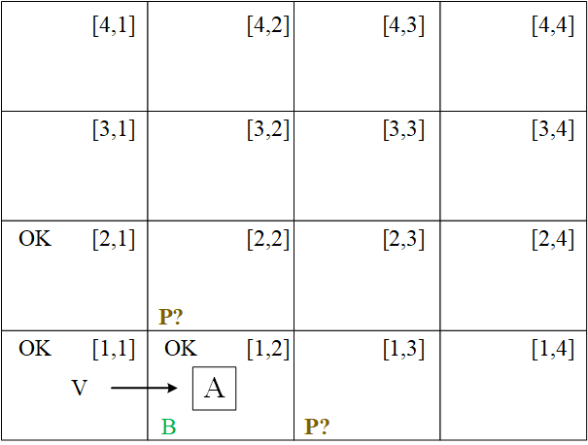
Wumpus World Solution
Step 2:
  A perceives a Breeze in room [1,2] → room [1,3] and [2,2] may have pits
  Action: calculate penalty for each unexplored room and move to least penalty room, i.e. move to [2,1] via room [1,1]
  Anticipated Penalty for room [1,3] = -1000
  Anticipated Penalty for room [2,2] = -1000
  Penalty for room [2,1] via room [1,1] = -2

Slide 66
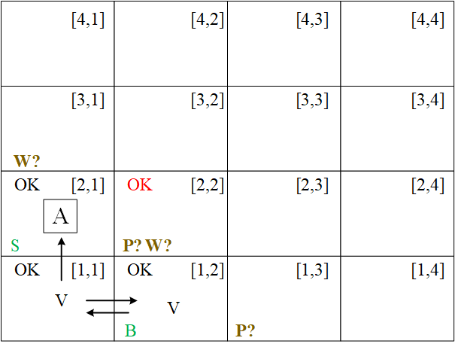
Wumpus World Solution
Step 3:
  A perceives a Stench in room [2,1] → room [3,1] and [2,2] may have Wumpus
  The agent observes a conflict in logic in room [2,2]:
    When A was in room [1,2] there was no stench, thus room [2,2] cannot have Wumpus
    Room [2,1] does not have a breeze and hence there cannot be a pit in room [2,2].
    Therefore, A concludes that room [2,2] is safe and marks it as OK.
  Action Move to room [2,2]

Slide 67
Wumpus World Solution
Step 3:
  Wumpus → Stench
  [1,2] no stench → [2,2] no Wumpus
  Pit → Breeze
  [2,1] no Breeze → [2,2] no Pit
  Thus, [2,2] has no Wumpus and no Pit and is marked OK
  S in [2,1] → W in [3,1] V W in [2,2]
  Since W in [2,2]=F → W in [3,1]=T
  Thus, we conclude that Wumpus is in [3,1]

Slide 68
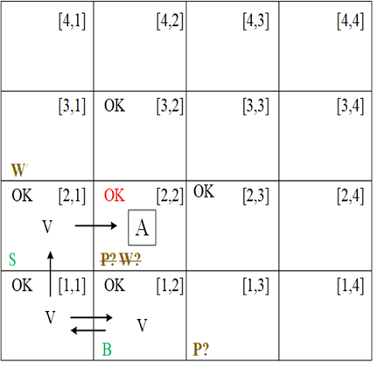
Wumpus World Solution
Step 4:
  A perceives nothing in room [2,2] → Mark room [2,3] and [3,2] as OK
  Choices:
    Move to room [2,3] or [3,2] since they are safe
  Action: move to room [2,3]

Slide 69
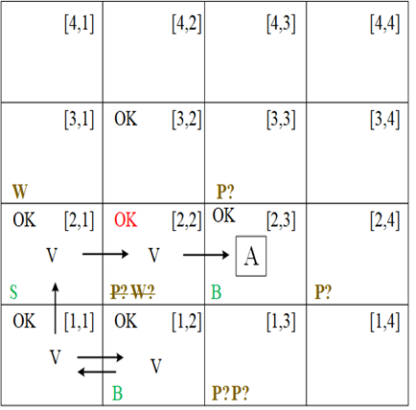
Wumpus World Solution
Step 5:
  A perceives a Breeze in room [2,3] → rooms [3,3] and [2,4] may have pits.
  Action: estimate penalty in each room → move to room [3,2]

Slide 70
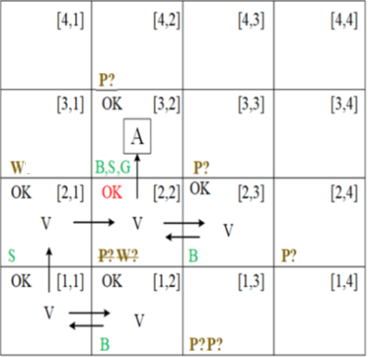
Wumpus World Solution
Step 6:
  A perceives a Stench, Breeze and Glitter in room [3,2]→ grab the gold.
Step 7: To get out backtrack your steps by maximizing Utility (or minimizing penalty)
  Backtrack path [3,2] → [2,2] → [2,1] → [1,1]
Try it out: http://primaryobjects.github.io/wumpus/

Slide 71
Conclusion
Knowledge representation plays a big role in an agent's behavior.
We utilize propositional logic and other types of logic for knowledge representation.
Inference logic is needed to infer new knowledge from known knowledge.

Slide 72
Play The Wumpus World Online
https://thiagodnf.github.io/wumpus-world-simulator/
https://luka1199.github.io/wumpus-world/
https://osric.com/wumpus/

